Slide 1

6th Grade Math
Unit 1, Lesson 2 Adding and Subtracting Fractions Volume 1, pg. 8

Slide 2



Benchmark
MA.5.AR.1.2
Solve real-world problems involving the addition, subtraction, or multiplication of fractions, including mixed numbers and fractions greater than $1$.
volume 1, pg. 8

Slide 3
Integrated Mathematical Thinking and Reasoning Standards
MA.K12.MTR.1.1 Actively participate in effortful learning both individually and collectively.
MA.K12.MTR.2.1 Demonstrate understanding by representing problems in multiple ways.
MA.K12.MTR.4.1 Engage in discussions that reflect on the mathematical thinking of self and others.
MA.K12.MTR.5.1 Use patterns and structure to help understand and connect mathematical concepts.
MA.K12.MTR.7.1 Apply mathematics to real-world contexts.
volume 1, pg. 8

Slide 4

Learning Target
I can solve real-world problems involving adding and subtracting fractions.
volume 1, pg. 8

Slide 5

Warm-Up
volume 1, pg. 8

Slide 6
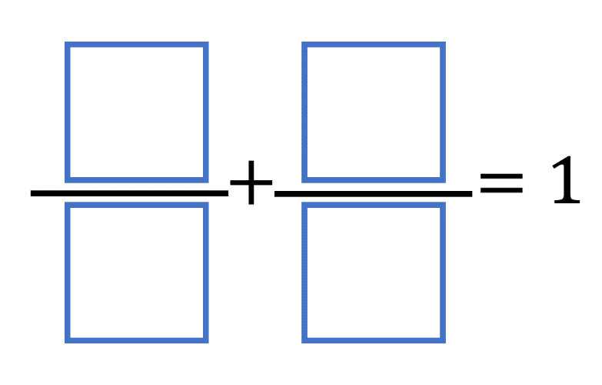
1.2.1 Warm-Up: True Statement
Place a digit in each blue box to make the statement true. Use only digits 1 to 9, at most one time each.
volume 1, pg. 8

Slide 7

Exploration
volume 1, pg. 9

Slide 8


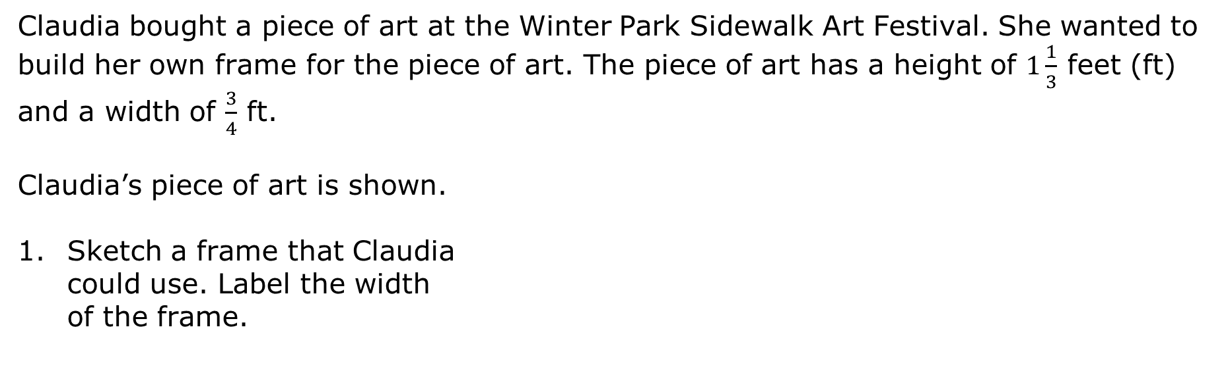
1.2.2 Exploration: Framing a Piece of Art
Claudia bought a piece of art at the Winter Park Sidewalk Art Festival. She wanted to build her own frame for the piece of art. The piece of art has a height of $1\frac{1}{3}$ feet (ft) and a width of $\frac{3}{4}$ ft.
Claudia’s piece of art is shown.
Sketch a frame that Claudia
could use. Label the width
of the frame.
volume 1, pg. 9

Slide 9
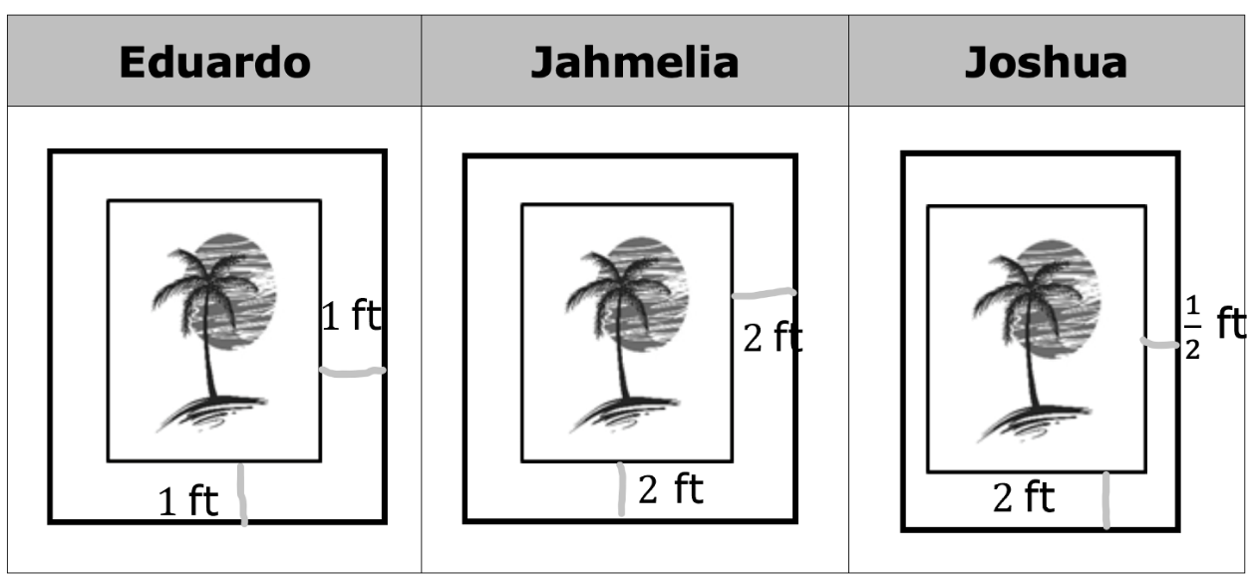
The sketches of the frames of three classmates are shown.
volume 1, pg. 9

Slide 10
Which of these frames, when combined with the art piece, will produce a height that is 4 ft. taller than the original piece of art?
Whose frame, when combined with the art piece, will produce a width that is 1 ft. longer than the original art piece?
The frames of Eduardo, Jahmelia, and Joshua show that the width of the frame can vary. Joshua’s frame shows that the frame does not have to be the same width on all four sides.
volume 1, pg. 9

Slide 11
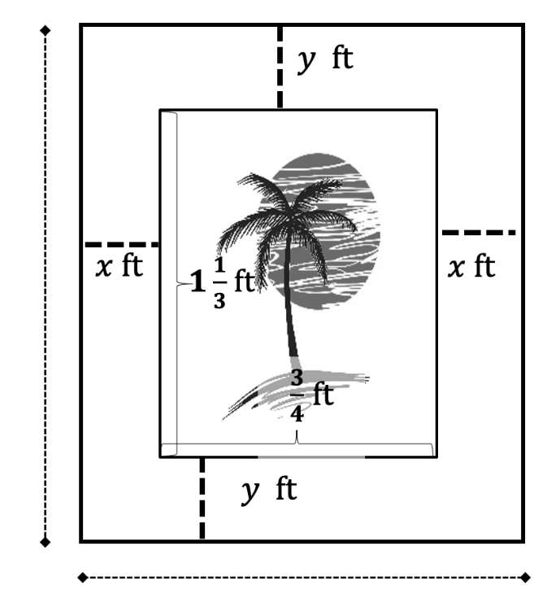
Claudia wants to determine the amount of wood she needs to frame the piece of art. Since she is not sure of the widths of the frame, she labels the dimensions, as shown.
Work with your partner to write an expression that represents the width.
height
width
Work with your partner to write an expression that represents the height.
volume 1, pg. 10

Slide 12

Guided Instruction
volume 1, pg. 10

Slide 13
1.2.3 Guided Instruction: Adding and Subtracting Fractions with Unlike Denominators
One way to add or subtract fractions, is to first find
______________ fractions that have common, or
______________ denominators.
To find a common denominator for fractions, write
the of the numbers in the
denominators.
factors
multiples
volume 1, pg. 10

Slide 14
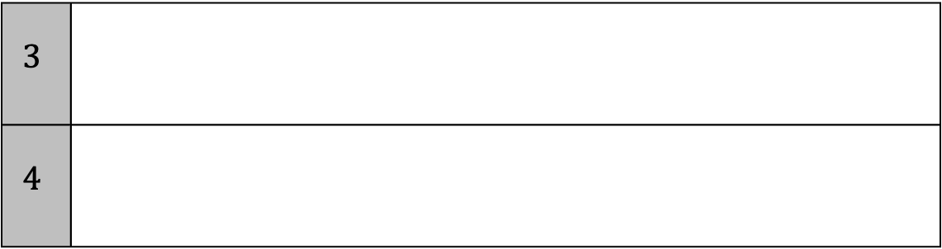
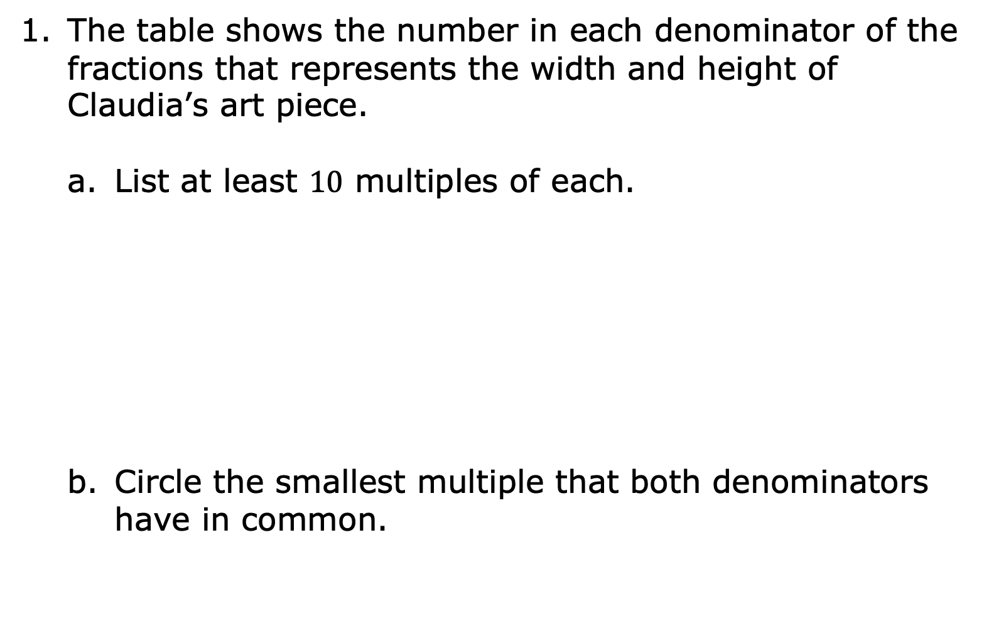
The table shows the number in each denominator of the fractions that represents the width and height of Claudia’s art piece.
List at least $10$ multiples of each.
Circle the smallest multiple that both denominators have in common.
$$3$$
$$4$$
volume 1, pg. 10

Slide 15
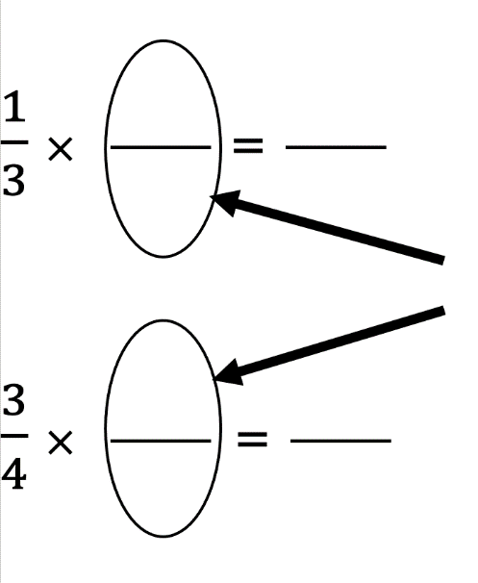


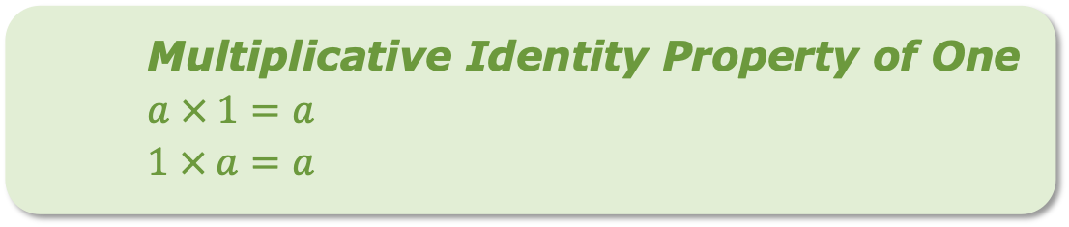
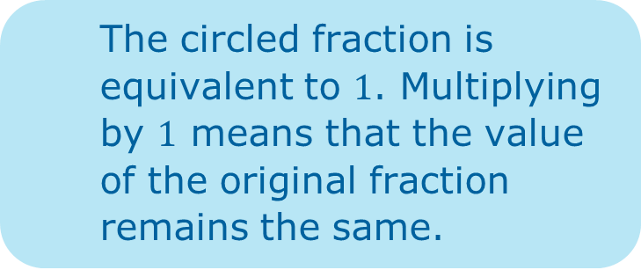
Working with only the fractional portion of each number, multiply both the numerator and the denominator by the factor that will result in the circled denominator.
The circled fraction is equivalent to 1. Multiplying by $1$ means that the value of the original fraction remains the same.
Multiplicative Identity Property of One
$$a × 1=a$$
$1 × a=a$
volume 1, pg. 11

Slide 16
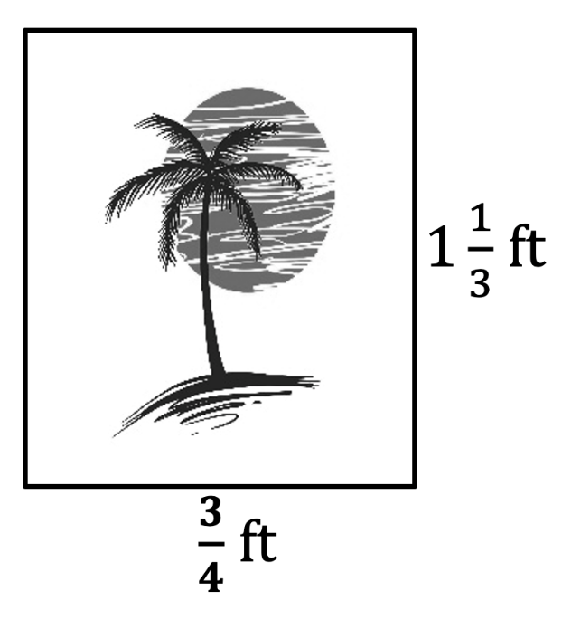
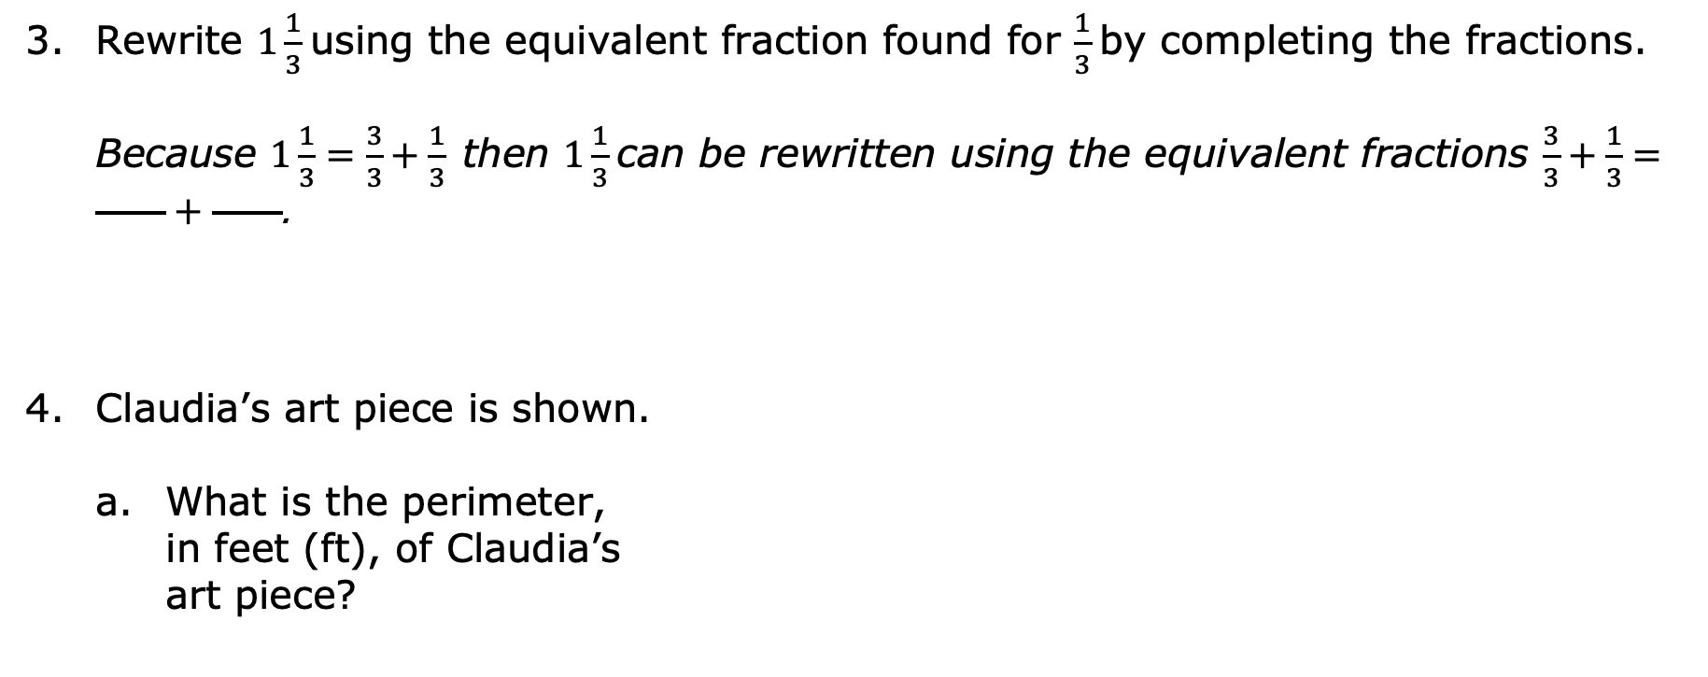
Rewrite $1\frac{1}{3}$ using the equivalent fraction found for $\frac{1}{3}$ by completing the fractions.
Because $1\frac{1}{3}=\frac{3}{3}+\frac{1}{3}$ then $1\frac{1}{3}$ can be rewritten using the equivalent fractions $\frac{3}{3}+\frac{1}{3}=\frac{ }{ }+\frac{ }{ }$.
Claudia’s art piece is shown.
What is the perimeter,
in feet (ft), of Claudia’s
art piece?
volume 1, pg. 11

Slide 17
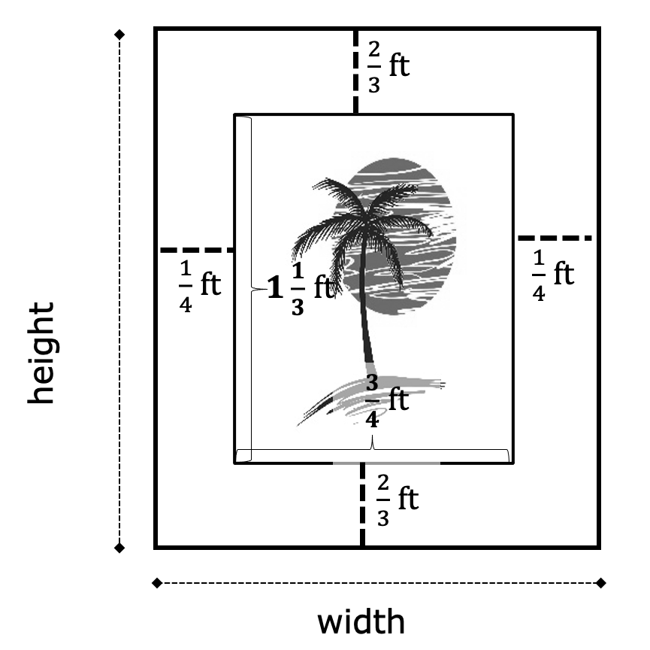
Claudia decides to build a frame with the following dimensions.
volume 1, pg. 11

Slide 18
Write the numerical expression that represents the total width of the frame and art piece.
Find the total width, in ft.
Write the numerical expression that represents the total height of the frame and art piece.
Find the total height, in ft.
volume 1, pg. 11

Slide 19

Guided Practice
volume 1, pg. 12

Slide 20

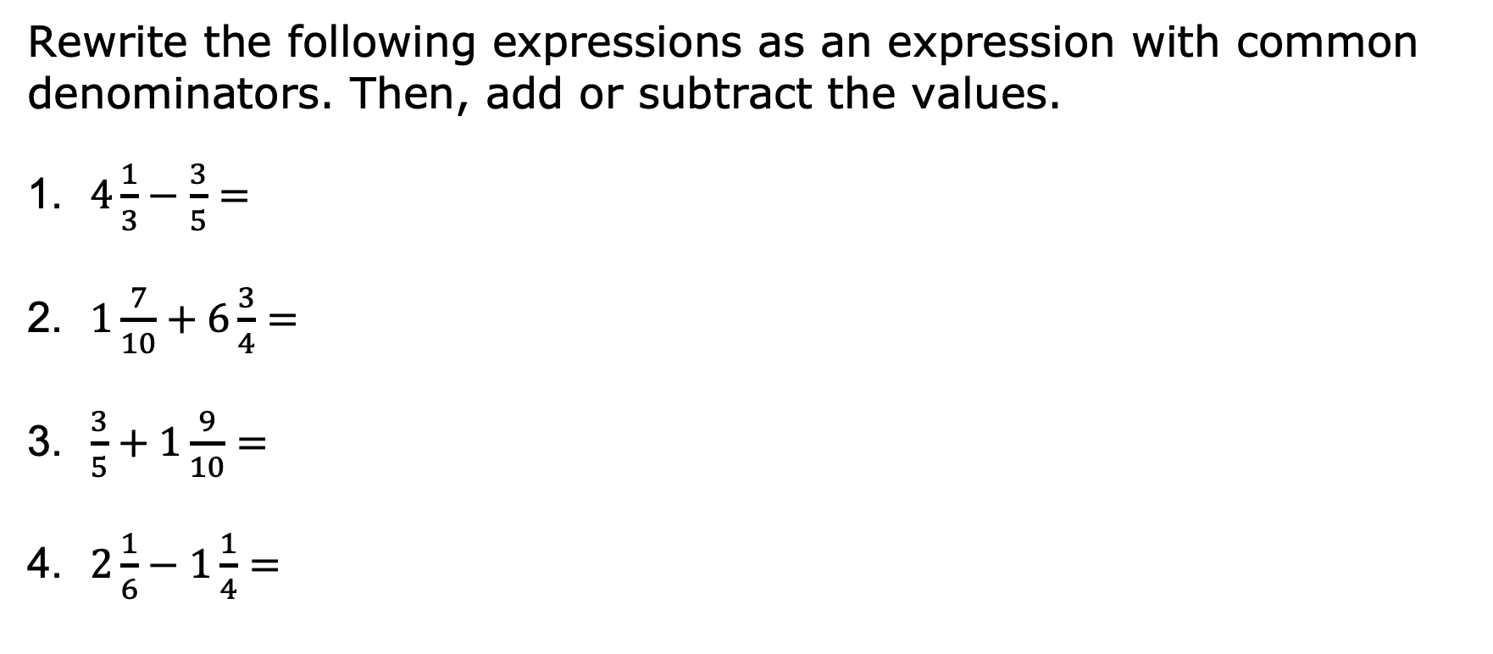
1.2.4 Guided Practice: Adding and Subtracting Fractions with Unlike Denominators
Rewrite the following expressions as an expression with common denominators. Then, add or subtract the values.
1. $4\frac{1}{3}−\frac{3}{5}=$
2. $1\frac{7}{10}+6\frac{3}{4}=$
3. $\frac{3}{5}+1\frac{9}{10}=$
4. $2\frac{1}{6}−1\frac{1}{4}=$
volume 1, pg. 12

Slide 21

Wrap-Up
volume 1, pg. 13

Slide 22
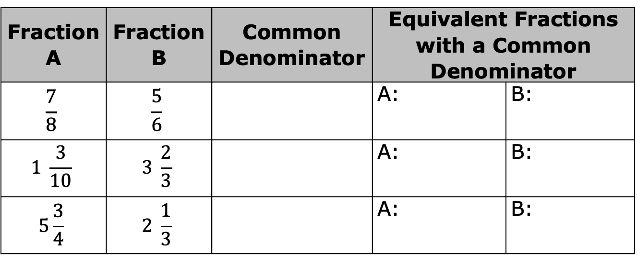
1.2.5 Wrap-Up: Ticket Out the Door
Use the table below to answer the questions.
Complete the table. First, find the common denominator for Fraction A and Fraction B. Then, rewrite Fraction A and Fraction B using the common denominator.
Fraction A | Fraction B | Common Denominator | Equivalent Fractions with a Common Denominator
$$\frac{7}{8}$$ | $$\frac{5}{6}$$ |  | A: | B:
$$1 \frac{3}{10}$$ | $$3 \frac{2}{3}$$ |  | A: | B:
$$5\frac{3}{4}$$ | $$2 \frac{1}{3}$$ |  | A: | B:
volume 1, pg. 13

Slide 23
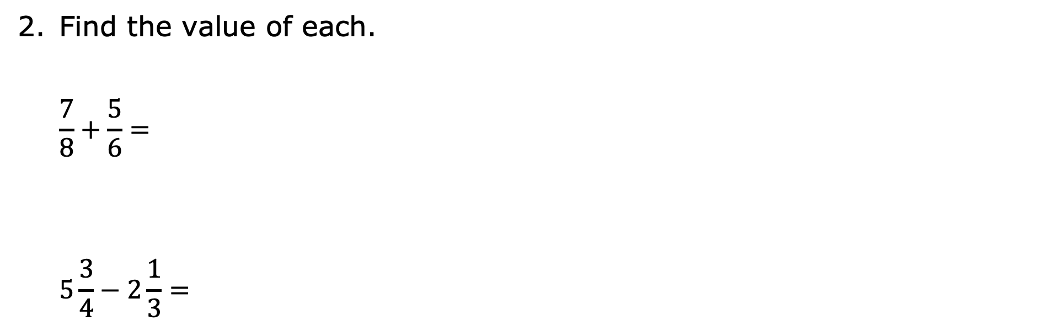
Find the value of each.
$$\frac{7}{8}+\frac{5}{6}=$$
$$5\frac{3}{4}−2\frac{1}{3}=$$
volume 1, pg. 13

